Slide 1
Normalization in DBMS
• Functional Dependencies
• 1NF to 5NF
• Examples
1

Slide 2
Learning Objectives
Explain why normalization is required in relational database design.
Identify functional dependencies, candidate keys, prime attributes, and determinants.
Transform relations systematically into 1NF, 2NF, 3NF, and BCNF.
Understand 4NF and 5NF and when they become relevant.
Perform lossless-join and dependency-preservation analysis.
Recognize anomalies and trade-offs between normalization and performance.
2

Slide 3
Why Normalize?
Normalization organizes attributes and relationships so that each fact is stored in an appropriate place.
Main goals:
reduce redundancy
prevent update anomalies
improve integrity, and simplify maintenance.
Poorly designed tables often mix multiple independent facts in one relation.
Normalization is primarily a design technique—not simply a method of making tables smaller.
3

Slide 4
Why Normalize?
Typical symptoms of poor design
Repeated values
Conflicting copies of the same fact
NULL-heavy records
Difficult inserts/deletes
3

Slide 5
The Three Classic Anomalies
Anomaly | What happens | Example
Update | Same fact must be changed in many rows | Change instructor phone number
Insertion | Cannot store a fact without an unrelated fact | New course requires a student row
Deletion | Deleting one fact accidentally removes another | Last enrollment deletes course information
4

Slide 6
Running Example: Student–Course Enrollment
StudentID | StudentName | CourseID | CourseName | Instructor | Grade
S101 | Asha | C101 | DBMS | Dr Rao | A
S101 | Asha | C102 | OS | Dr Mehta | B+
S102 | Vikram | C101 | DBMS | Dr Rao | A-
S103 | Neha | C103 | AI | Dr Shah | A
A single row mixes student facts, course facts, instructor facts, and enrollment facts.
5

Slide 7
Functional Dependency (FD)
A functional dependency X → Y means: if two tuples agree on X, they must also agree on Y.
X is the determinant; Y is functionally dependent on X.
Example: StudentID → StudentName.
Example: CourseID → CourseName, Instructor.
FDs are semantic rules about the data—not merely patterns observed in a sample.
Notation
X → Y means X uniquely determines Y
6

Slide 8
Keys and Attribute Concepts
Concept | Meaning | Example
Superkey | Any attribute set that uniquely identifies a tuple | {StudentID, CourseID}
Candidate key | Minimal superkey | {StudentID, CourseID}
Primary key | Candidate key selected to identify rows | StudentID + CourseID
Prime attribute | Attribute belonging to a candidate key | StudentID, CourseID
Non-prime attribute | Attribute not belonging to any candidate key | StudentName, Grade
7

Slide 9
Attribute Closure
The closure X⁺ is the set of attributes functionally determined by X under a set of FDs.
Use closure to test whether X is a superkey: if X⁺ contains every attribute in the relation, X is a superkey.
Closure is also useful for finding candidate keys and checking FD implication.
Algorithm:
1. start with X;
2. Repeatedly add attributes implied by applicable FDs until no new attribute can be added.
Example: F = {A→B, B→C, C→D}; A⁺ = {A,B,C,D}
8

Slide 10
First Normal Form (1NF)
A relation is in 1NF when attribute values are atomic with respect to the chosen relational model.
No repeating groups or multi-valued fields are stored as a single cell.
Each row represents one tuple and each column represents one attribute domain.
1NF does not eliminate redundancy by itself.
Not 1NF: PhoneNumbers = {9876…, 9123…} in one field
1NF: store phone values as separate rows in a related relation, if multiple phone numbers are permitted.
9

Slide 11
Second Normal Form (2NF)
A relation is in 2NF if it is in 1NF and every non-prime attribute is fully functionally dependent on every candidate key.
Partial dependency occurs when a non-key attribute depends on only part of a composite candidate key.
2NF matters primarily when a candidate key has multiple attributes.
With a single-attribute key, a 1NF relation is automatically in 2NF.
Enrollment(StudentID, CourseID, StudentName, CourseName, Grade)
Key = {StudentID, CourseID}; StudentID → StudentName and CourseID → CourseName are partial dependencies.
10

Slide 12
Converting the Example to 2NF
Before | Problem | After
Enrollment(StudentID, CourseID, StudentName, CourseName, Grade) | StudentName depends only on StudentID; CourseName only on CourseID | Student(StudentID, StudentName)
 |  | Course(CourseID, CourseName, Instructor)
 |  | Enrollment(StudentID, CourseID, Grade)
Each relation now stores facts that depend on its key rather than on only part of a composite key.
11

Slide 13
Third Normal Form (3NF)
A relation is in 3NF if it is in 2NF and has no problematic transitive dependency of a non-prime attribute on a key through another non-key attribute.
Formal test: for every non-trivial FD X → A, either X is a superkey or A is prime.
Classic pattern: Key → Non-key B → Non-key C.
3NF is often the practical target for OLTP relational schemas.
Example: CourseID → InstructorID and InstructorID → InstructorName
Decompose into Course(CourseID, InstructorID) and Instructor(InstructorID, InstructorName).
12

Slide 14
Boyce–Codd Normal Form (BCNF)
BCNF is stricter than 3NF.
For every non-trivial FD X → Y, X must be a superkey.
Every determinant must therefore be a candidate key or contain one.
Some relations satisfy 3NF but not BCNF because a non-key determinant exists.
Rule of thumb: 3NF permits certain dependencies when the dependent attribute is prime; BCNF does not.
13

Slide 15
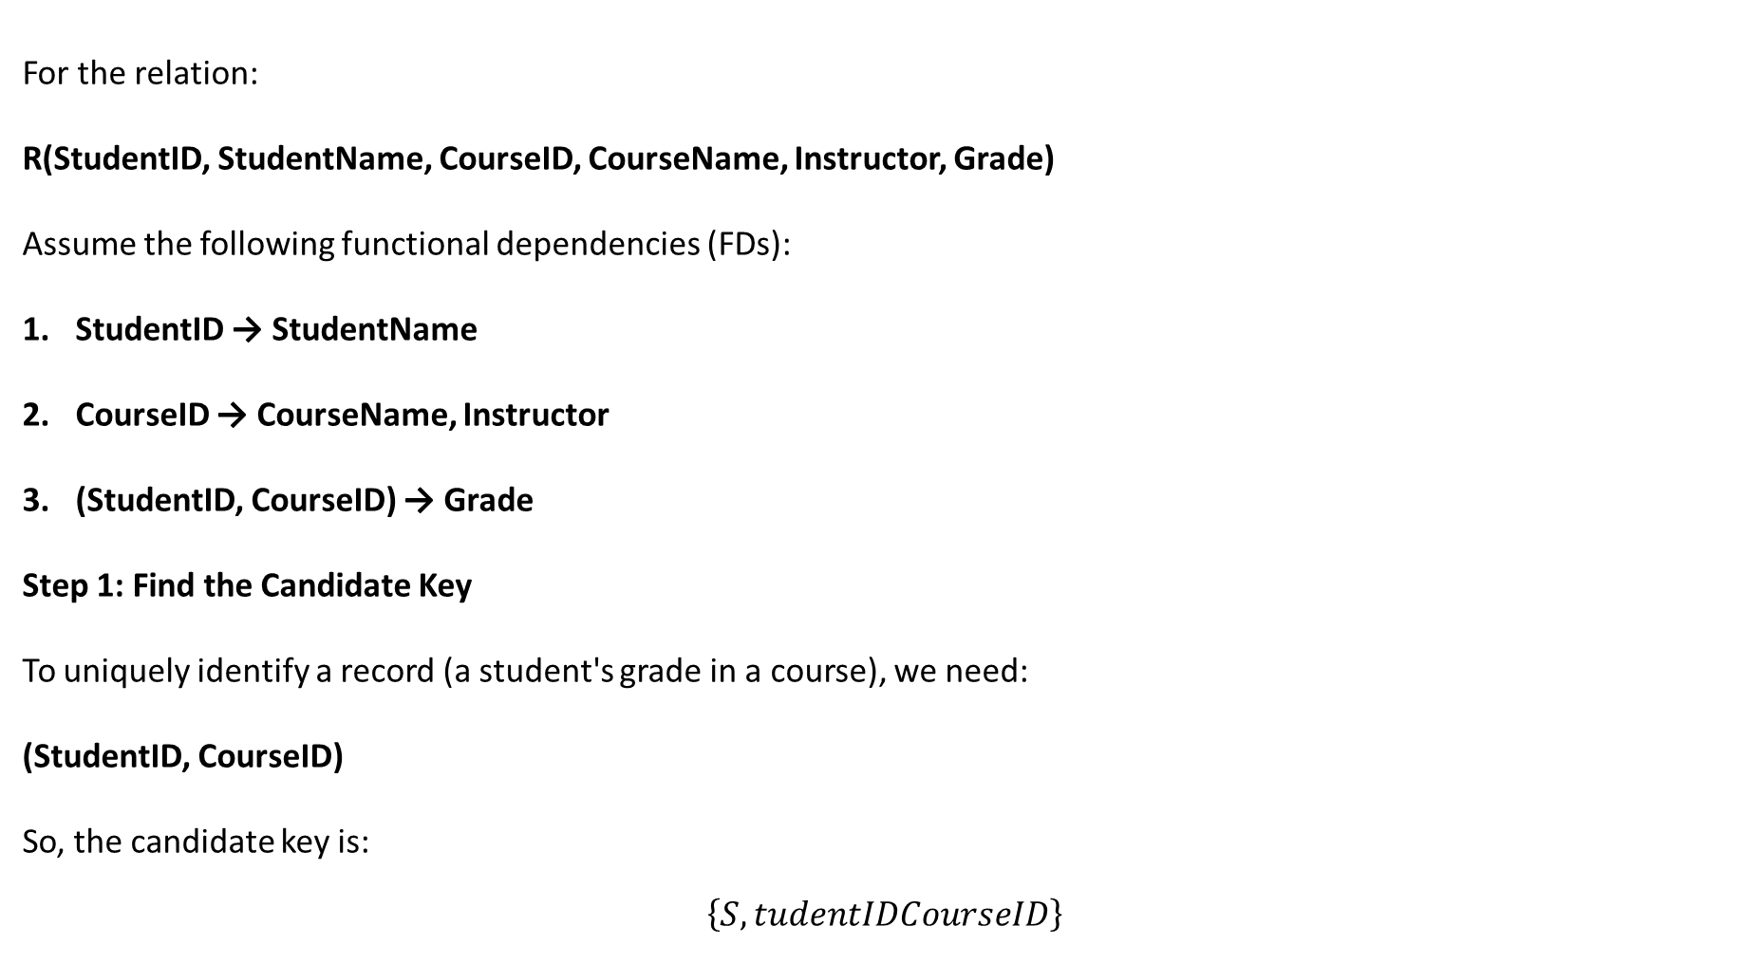
For the relation:
R(StudentID, StudentName, CourseID, CourseName, Instructor, Grade)
Assume the following functional dependencies (FDs):
StudentID → StudentName
CourseID → CourseName, Instructor
(StudentID, CourseID) → Grade
Step 1: Find the Candidate Key
To uniquely identify a record (a student's grade in a course), we need:
(StudentID, CourseID)
So, the candidate key is:
$$\left\{S , tudentIDCourseID\right\}$$

Slide 16

Step 2: Check BCNF Condition
A relation is in BCNF if for every non-trivial FD:
$$X→Y$$
the determinant X must be a superkey.
Let's examine the FDs:
FD | Is Left Side a Superkey? | BCNF Violation?
StudentID → StudentName | No | Yes
CourseID → CourseName, Instructor | No | Yes
(StudentID, CourseID) → Grade | Yes | No

Slide 17

Step 3: Decompose into BCNF Relations
Relation 1: Students
STUDENT(StudentID, StudentName)
FD:
$$StudentID→StudentName$$
StudentID is the key.
Therefore, BCNF satisfied.
Relation 2: Courses
COURSE(CourseID, CourseName, Instructor)
FD:
$$CourseID→CourseName,Instructor$$
CourseID is the key.
Therefore, BCNF satisfied.
Relation 3: Enrollments
ENROLLMENT(StudentID, CourseID, Grade)
FD:
$$\left(S , tudentIDCourseID\right)→Grade$$
(StudentID, CourseID) is the key.
Therefore, BCNF satisfied.

Slide 18
Final BCNF Decomposition
STUDENT(StudentID, StudentName)
COURSE(CourseID, CourseName, Instructor)
ENROLLMENT(StudentID, CourseID, Grade)

Slide 19
3NF vs BCNF
Property | 3NF | BCNF
Core condition | X is superkey OR Y is prime | X must be a superkey
Strength | Less restrictive | Stronger
Dependency preservation | Can often be achieved | May be lost after decomposition
Lossless decomposition | Can be designed to be lossless | Can be designed to be lossless
Typical use | Practical OLTP target | Use when stronger redundancy control is needed
15

Slide 20
Lossless-Join Decomposition
A decomposition is lossless if joining the decomposed relations reconstructs exactly the original relation—no spurious tuples and no lost tuples.
For binary decomposition R → R1, R2, a standard test is that the common attributes functionally determine all attributes of R1 or all attributes of R2 under F⁺.
Losslessness is essential: normalization must not change the meaning of valid data.
Think: decomposition should separate facts without inventing new combinations when tables are joined.
16

Slide 21
Dependency Preservation
A decomposition preserves dependencies if the original FDs can be enforced by checking the decomposed relations individually, without joining them.
Dependency preservation simplifies constraint enforcement.
3NF synthesis can guarantee a lossless, dependency-preserving decomposition.
BCNF decomposition may sacrifice dependency preservation.
Design trade-off: stronger normalization vs. convenient enforcement of all original dependencies.
17

Slide 22
3NF Synthesis: High-Level Procedure
1. Compute a minimal/canonical cover of the functional dependencies.
2. For each FD X → Y in the cover, create a relation containing X ∪ Y.
3. If no created relation contains a candidate key of the original relation, add one relation containing a candidate key.
4. Remove redundant relations that are subsets of others.
5. The resulting decomposition is designed to be lossless and dependency-preserving.
18

Slide 23
Fourth Normal Form (4NF)
4NF addresses multivalued dependencies (MVDs), not just functional dependencies.
An MVD X ↠ Y means that, given X, the set of Y values is independent of the remaining attributes.
4NF requires every non-trivial MVD X ↠ Y to have X as a superkey.
Typical problem: one entity independently has many values of two different attributes.
Example: Student(StudentID, Hobby, Language) can create a cross-product of hobbies and languages.
Decompose: StudentHobby(StudentID, Hobby) and StudentLanguage(StudentID, Language).
19

Slide 24
Fifth Normal Form (5NF / PJNF)
5NF addresses join dependencies and cases where a relation should be decomposed into three or more projections.
A relation is in 5NF when every non-trivial join dependency is implied by candidate keys.
5NF is relatively uncommon in everyday application schemas.
It becomes relevant in complex many-to-many-to-many business rules where redundancy persists after 4NF.
20

Slide 25
Normal Forms at a Glance
Normal Form | Primary concern | Typical violation
1NF | Atomic values / no repeating groups | Multiple values in one cell
2NF | No partial dependency on composite key | StudentID → StudentName
3NF | No inappropriate transitive dependency | InstructorID → InstructorName
BCNF | Every determinant is a superkey | Non-key determinant
4NF | No problematic multivalued dependencies | Independent hobby/language sets
5NF | No problematic join dependencies | Complex ternary relationship
21

Slide 26
Worked Example: From Unnormalized Design to 3NF
UNF: StudentID, StudentName, {CourseID, CourseName, Instructor, Grade}
1NF: flatten the repeating course group into individual enrollment rows.
2NF: separate Student and Course facts from Enrollment because they depend on only part of the composite key.
3NF: separate Instructor information if CourseID → InstructorID and InstructorID → InstructorName.
Final schema: Student(StudentID, StudentName); Instructor(InstructorID, InstructorName); Course(CourseID, CourseName, InstructorID); Enrollment(StudentID, CourseID, Grade).
22

Slide 27
Normalization vs. Denormalization
Normalization | Denormalization
Reduces redundancy | Intentionally introduces controlled redundancy
Fewer update anomalies | May simplify/accelerate reads
More joins may be required | Fewer joins may be required
Strong fit for transactional integrity | Often useful for reporting/analytics or performance hotspots
Default design strategy | Use deliberately after measuring workload
Denormalize for a measured reason—not because joins are automatically bad.
23

Slide 28
Practical Design Checklist
Identify entities, attributes, and relationships before splitting tables.
State business rules as functional/multivalued dependencies where possible.
Find candidate keys—not only a convenient primary key.
Check 1NF → 2NF → 3NF/BCNF systematically.
Verify lossless join and dependency preservation after decomposition.
Add primary keys, foreign keys, UNIQUE and CHECK constraints as appropriate.
Benchmark real queries before considering denormalization.
24

Slide 29
Common Misconceptions
“One table per entity” is not the same as being fully normalized.
Normalization does not mean every table must have exactly one non-key attribute.
3NF and BCNF are not interchangeable.
An FD observed in a small sample is not necessarily a business rule.
Foreign keys do not by themselves guarantee normalization.
Normalization is about dependencies and facts, not simply the number of columns.
25

Slide 30
Normalized Schema: SQL Sketch
CREATE TABLE Student (
StudentID INT PRIMARY KEY,
StudentName VARCHAR(100) NOT NULL
);
CREATE TABLE Instructor (
InstructorID INT PRIMARY KEY,
InstructorName VARCHAR(100) NOT NULL
);
26

Slide 31
Normalized Schema: SQL Sketch
CREATE TABLE Course (
CourseID INT PRIMARY KEY,
CourseName VARCHAR(100) NOT NULL,
InstructorID INT NOT NULL,
FOREIGN KEY (InstructorID) REFERENCES Instructor(InstructorID)
);
CREATE TABLE Enrollment (
StudentID INT,
CourseID INT,
Grade VARCHAR(5),
PRIMARY KEY (StudentID, CourseID),
FOREIGN KEY (StudentID) REFERENCES Student(StudentID),
FOREIGN KEY (CourseID) REFERENCES Course(CourseID)
);
26

Slide 32
Key Takeaways
Normalization is a dependency-driven method for designing reliable relational schemas.
1NF handles atomicity; 2NF removes partial dependencies; 3NF controls transitive dependencies.
BCNF strengthens 3NF by requiring every determinant to be a superkey.
4NF handles multivalued dependencies; 5NF handles join dependencies.
Good decomposition should preserve meaning—especially losslessness—and preferably preserve dependencies.
Use normalization as the default, then denormalize only when workload evidence justifies it.
27

Slide 33
Classroom Exercise / Discussion
Given:
Order(OrderID, CustomerID, CustomerName, ProductID, ProductName, Quantity, SalespersonID, SalespersonName)
Assume: CustomerID → CustomerName; ProductID → ProductName; SalespersonID → SalespersonName.
OrderID + ProductID → Quantity.
1. Identify candidate keys and prime attributes.
2. Identify partial and transitive dependencies.
3. Decompose the relation to 3NF.
4. Identify primary and foreign keys in the final schema.
5. Discuss whether BCNF changes the result.
28

Slide 34
References / Further Reading
Ramez Elmasri & Shamkant B. Navathe, Fundamentals of Database Systems.
Abraham Silberschatz, Henry F. Korth & S. Sudarshan, Database System Concepts.
C. J. Date, An Introduction to Database Systems.
Jeffrey D. Ullman & Jennifer Widom, A First Course in Database Systems.
Raghu Ramakrishnan & Johannes Gehrke, Database Management Systems.
29

